Slide 1




INTERNSHIP PROJECT PRESENTATION
DOG VS CAT IMAGE CLASSIFICATION
Presented by: Ashika Thakur
Internship Program: PBEL-IBM Virtual Internship
Organization: IBM
Mentor: Mr. Abhishek Singh

Slide 2
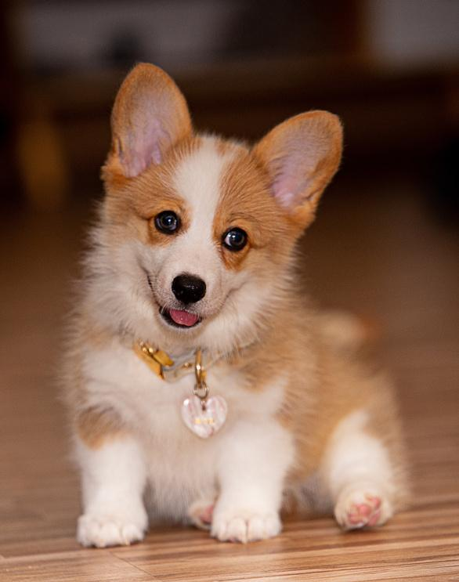
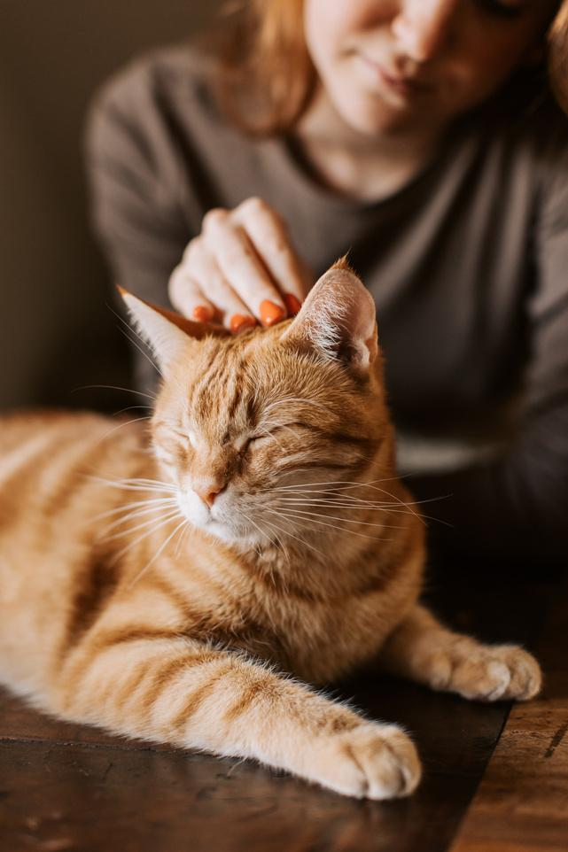
INTRODUCTION
Image classification is a key application of Artificial Intelligence and Deep Learning.
Convolutional Neural Networks (CNNs) are widely used for image recognition tasks.
This project focuses on classifying images into Dog or Cat.
The model learns visual features directly from image data.

Slide 3
PROBLEM STATEMENT & DATASET
Problem Statement
Given an input image, classify whether it contains a Dog or a Cat.
Manual classification is inefficient and prone to errors.
Dataset
Dataset contains unlabeled images of dogs and cats.
Images are resized to a fixed dimension.
Pixel values are normalized for better model performance.
Images of cats and dogs are provided a label(like as 0 & 1).
Dataset is split into training and testing sets.

Slide 4
METHODOLOGY & MODEL
Methodology
Image preprocessing and resizing
Data normalization
Model built using Convolutional Neural Network (CNN)
Model trained using labeled image data
Performance evaluated using accuracy and loss
Model
Convolutional layers for feature extraction.
GlobalAveragePooling2D performing dimensionality reduction.
Fully connected (Dense) layers for classification.
Softmax activation function for binary output.

Slide 5
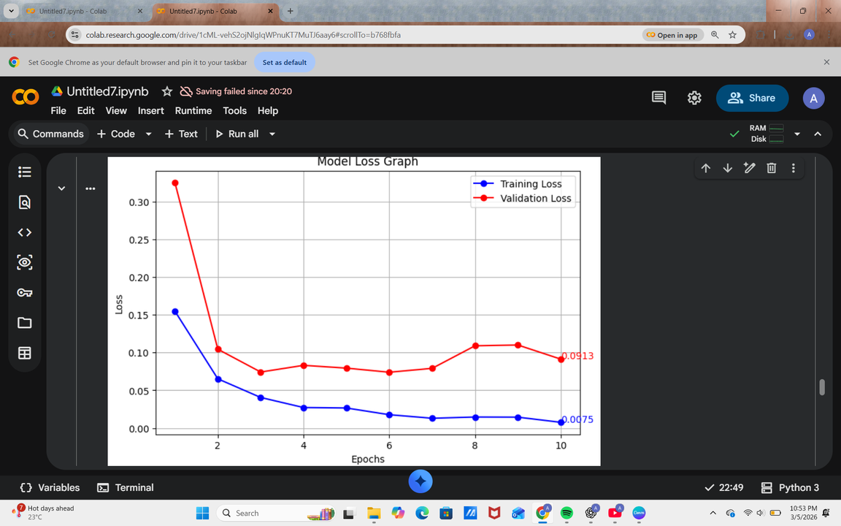
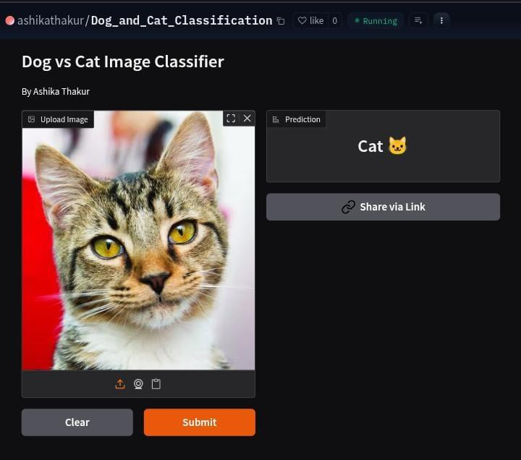
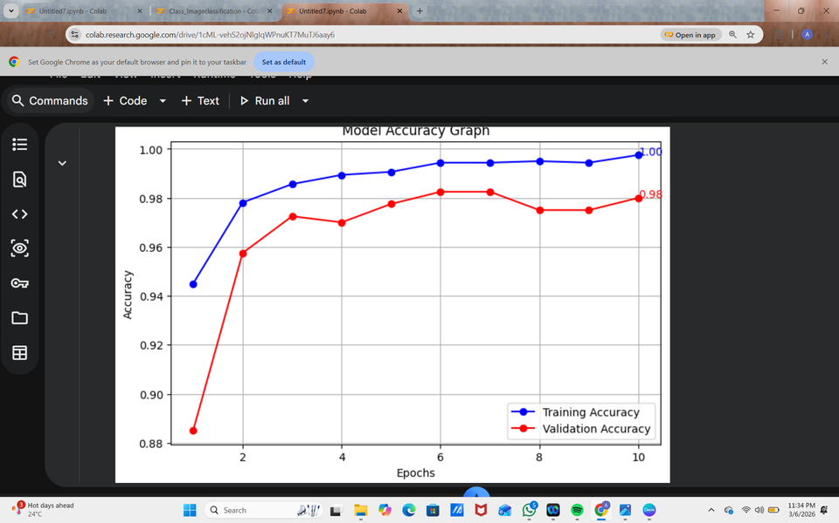
RESULTS & MODEL PERFORMANCE
CNN model trained to classify dog and cat images.
Accuracy improved while loss decreased over epochs.
Dashboard allows user to upload an image for prediction.
Live Demo :
https://huggingface.co/spaces/ashikathakur/Dog_and_Cat_Classification

Slide 6
THANK
YOU

